Slide 1
Session 2: Analog Input/Output, Servo Motor and Step Motor, and Conductive Materials

Slide 2
What We Learn Today
Analog Input and Output
PWM output
aout object
ain object
map object
voltage divider
Using an Analog Sensor as a switch
thresholding
triggering
Subpatch
Servomotor
Stepper Motor
Capacitive Sensing
Conductive Materials

Slide 3
Session 2.1: Analog Input and Output

Slide 4
Analog Output
Computers are digital.
Can’t use analog signals as it is.
Must be digital.
How can we use analog outputs with the Arduino?

Slide 5
Analog Output
Computers
are digital.
Can’t use analog signals as it is.
Must be digital.
How can we use analog outputs of the Arduino?
Digitize the analog output voltage ( the range: 0 (0v) – 255 (5v) )

Slide 6
Analog Output
Indeed, Arduino’s analog output is ‘PWM’ output,
PWM = Pulse With Modulation
PWM outputs can change the width of the pulse.
By controlling the width of the pulse, the output current is controlled.
Image: https://learn.sparkfun.com/tutorials/pulse-width-modulation (licensed under the CC BY-NC-SA 3.0 license)

Slide 7
Analog Output
Indeed, we already used the PWM output for Mini Speakers in Session 1!
Image: https://learn.sparkfun.com/tutorials/pulse-width-modulation (licensed under the CC BY-NC-SA 3.0 license)

Slide 8
Analog Output
NOTE:
Some Arduino family devices (such as Arduino Due) have Digital-to-Analog converters (DAC).
Such a devices can directly output analog voltages (with the given resolution) without PWM.

Slide 9
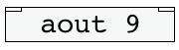
Aout object
The aout objects is used for analog output from Arduino.
When it receives an integer value between 0 - 255, it performs PWD output with the given value at the pin specified by its argument.
Not all the pins of Arduino Uno can perform PWM output. Use the pin with a tilda (‘~’) before its number, such as ~8, ~10, etc.

Slide 10
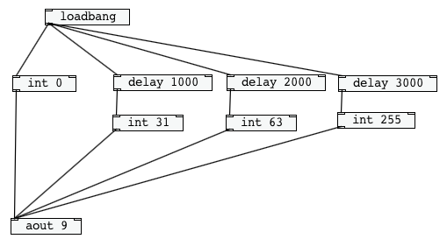
Ardestan: Example 01
use a pin with ‘~’ before the pin number.

Slide 11
Analog Input
Computers are digital.
Can’t use analog signals as it is.
Must be digital.
How can we use analog inputs of the Arduino?

Slide 12
Analog Input
Computers
are digital.
Can’t use analog signals as it is.
Must be digital.
How can we use analog inputs of the Arduino?
Digitize analog input voltage ( the range: 0 (0v) – 1023 (5v) )

Slide 13
Potentiometer
Let’s use a potentiometer to test the analog input patch.
A potentiometer is a three-terminal resistor, which is used as a voltage divider.
As its output voltage is changed by rotating the shaft, the Arduino can detect how much the shaft is rotated by measuring the input voltage.
Image: https://upload.wikimedia.org/wikipedia/commons/thumb/b/b5/Potentiometer.jpg/800px-Potentiometer.jpg . (license CC BY 2.5).

Slide 14
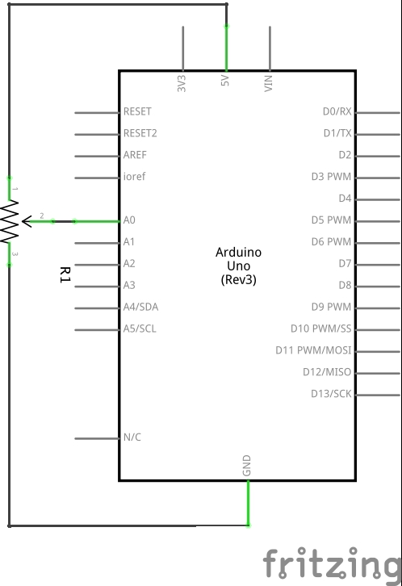
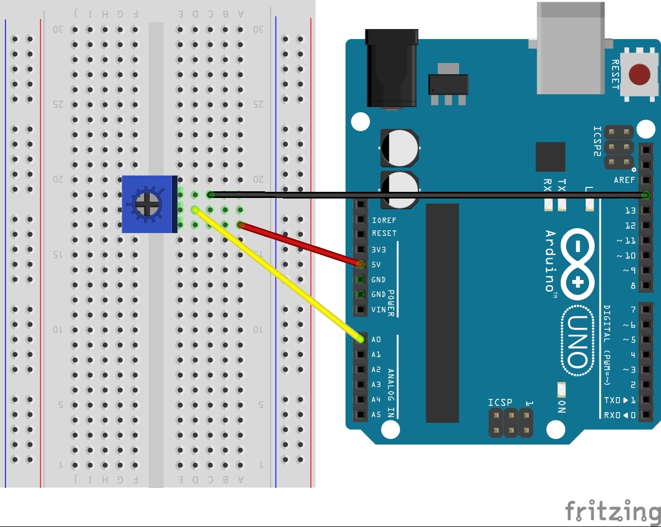
Analog Input
Create a circuit as below.

Slide 15
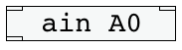
Ain Object
When the ain object received a bang message at its left inlet, it reads the analog input value at the given pin number, and then outputs it from the outlet.
The integer value will be between 0 (no input) and 1023 (the max input).

Slide 16
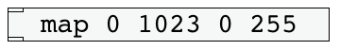

Map Object
When the map object received an integer value, it maps the integer value to a new range and then output it. The output value will be an integer (the decimal part will be floored).
63
560
888
1023
0
0
255
15
139
221

Slide 17
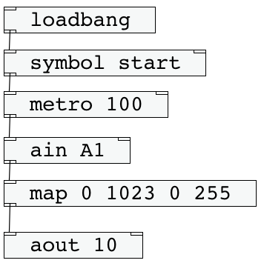
Ardestan: Example 02
This program checks analog input value every 100 msec (0 – 1023) and then remaps the value (0 – 255) to control the analog output.

Slide 18
Ardestan: Exercise 01
Design a circuit and test the below patch.
Use a potentiometer at Pin A1 and an LED at Pin 10.

Slide 19
Ardestan: Exercise 02
Extend the below program to use two analog inputs/outputs.

Slide 20
Voltage Divider
What’s inside a potentiometer?
Resistive Material

Slide 21
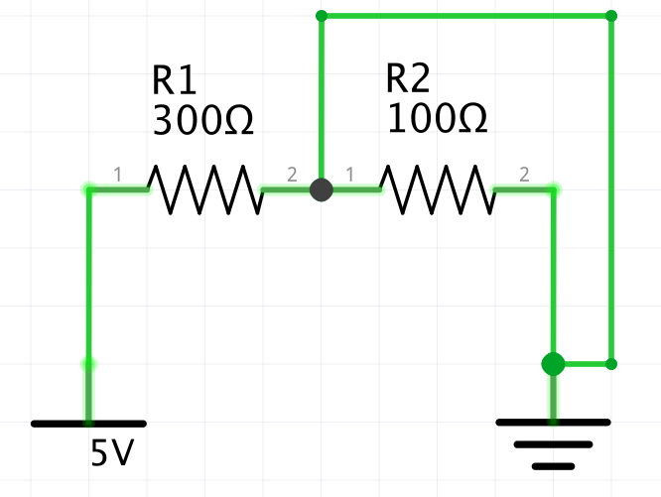
Voltage Divider
Why do resisters change the input voltage to an analog input? According to Ohm’s law, Vout = R2 / (R1 + R2) * Vin Hence, if R1 and/or R2 changes, Vout also changes. Many sensors are indeed resistors of this kind.
Calculate the Vout in the left figure.
Vout
Vin
GND

Slide 22
Voltage Divider
Many sensors are designed to be used in a voltage divider circuit or they may already have a built-in voltage divider inside.
photo resistor
flex sensor
pressure sensor
infrared proximity sensor
Images (L to R): https://www.sparkfun.com/products/9088 (license: CC BY 2.0)., https://www.sparkfun.com/products/10264 (license: CC BY 2.0), https://www.sparkfun.com/products/8713 (license: CC BY 2.0). https://www.sparkfun.com/products/242 8713 (license: CC BY 2.0).

Slide 23
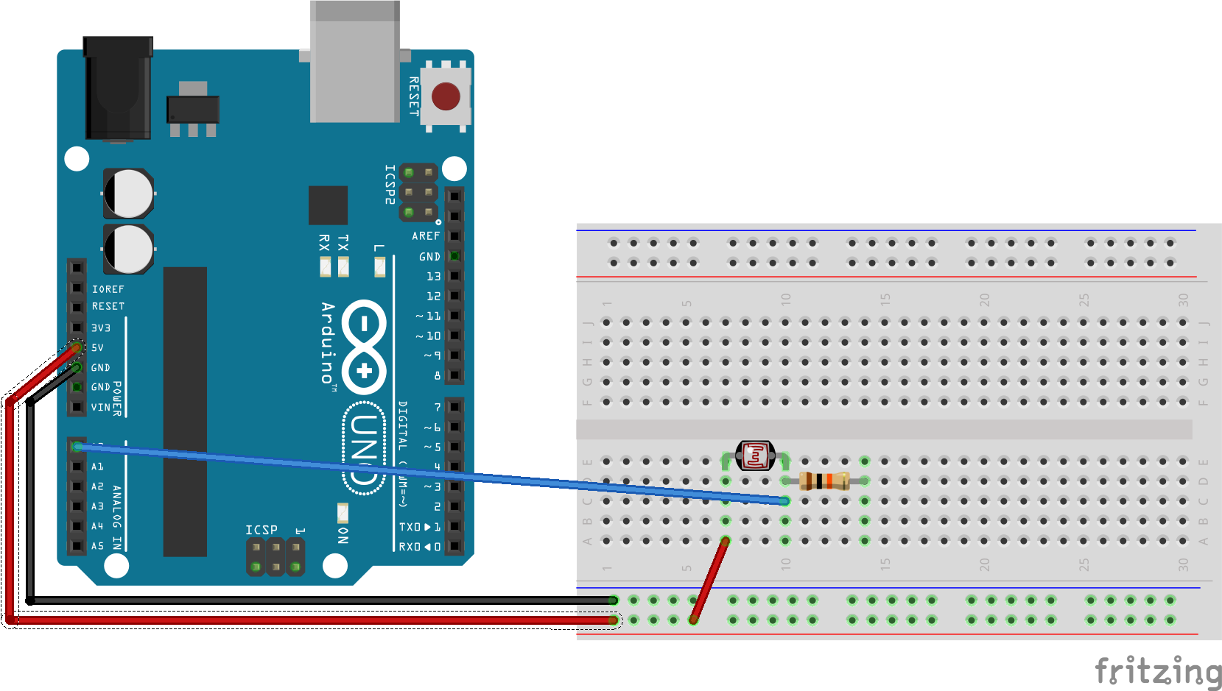
Ardestan: Exercise 03
Create a circuit with a photo resistor as below
First, print out the analog input from the photo resistor to the serial output (the resistor in the circuit is 10kΩ)
Then, control the brightness of the LED by the photo resistor.

Slide 24
What We Learned So Far
Analog Input and Output
PWM output
aout object
ain object
map object
voltage divider
Using an Analog Sensor as a switch
thresholding
triggering
Subpatch
Servomotor
Stepper Motor
Capacitive Sensing
Conductive Materials

Slide 25
Session 2.2: Using an Analog Sensor as a Switch

Slide 26
Thresholding by the Input Value
It is often useful to trigger some event when the analog input value go over a certain threshold.
For instance, when we use a flexi sensor, we may want to detect the event that the sensor was bent to a certain degree and trigger some event, rather than continuously checking how much it is bent.
Image: https://cdn.sparkfun.com//assets/parts/4/6/2/6/10264-01.jpg (license: CC BY-NC-SA 3.0).

Slide 27
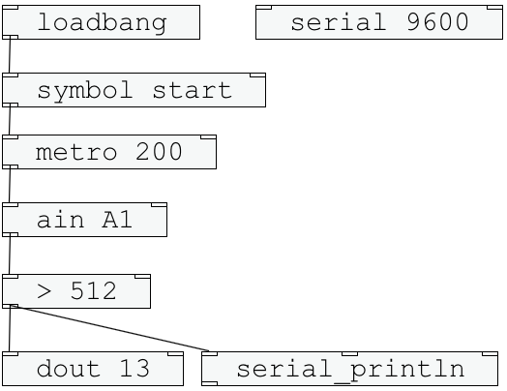
Thresholding by the Input Value
A simple LED on/off program by the analog input.

Slide 28
Triggering by the Input Value
We already know how to apply the time threshold to filter out unnecessary events (when we learned about contact bounces).
How we can detect when the analog input value go over a certain threshold? (when the value goes up from the below to the above the threshold).
analog input
the threshold value
time
we want to detect these crossings

Slide 29
Triggering by the Input Value
What does it mean ‘the value goes up from the below to the above the threshold’?
It means that the previous value was lower or equal to the threshold value and the new value is greater than the the threshold value.
analog input
the threshold value
time
we want to detect these crossings

Slide 30
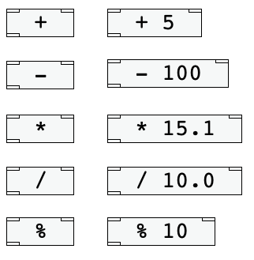
Arithmetic Operator
When it receives a value at the right inlet, it stores the value.
When it receives a value at the left inlet, it performs the arithmetic operation.
The default stored value can be given as an argument.
% is used for modulo.

Slide 31
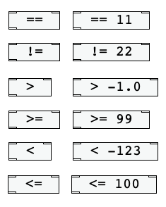
Relational Operator
A relational operator object compares two values.
If it received a value at the right inlet, it just stores it inside.
If it received a value at the left inlet, it compares the input value and the stored value.
If the condition is true, it outputs 1. If not, it outputs 0.
The default stored value can be given as an argument.

Slide 32
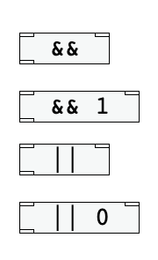
Logical Operator
A logical operator objects handles two Boolean values (true or false = non-zero or zero in Ardestan).
A logical-and object (&&) output 1 if both are true, 0 if either of two values is false.
A logical-or object (||) outputs 1 if either of two values is true, and 0 if both are false.
When it received a value at the right inlet, it just stores the value.
When it received a value at the left inlet, it performs the operation between the input value and the stored value.
The default value can be given as an argument.

Slide 33
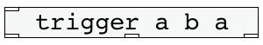
Trigger Object
When the trigger object received an input message, it first the given arguments and output the converted value in the order from the right inlet to the left outlet.
This object can be used to make it clear the order of the execution.

Slide 34
Trigger Object
The available arguments (used in this course) are a: anything this outputs the received message as it is b: bang this outputs a bang message.
For instance, when the above trigger object received an input message, it outputs the input message as it is from the right outlet first.
Then, it outputs a bang message from the middle inlets.
Finally, it outputs the input message as it is from the left inlet.

Slide 35
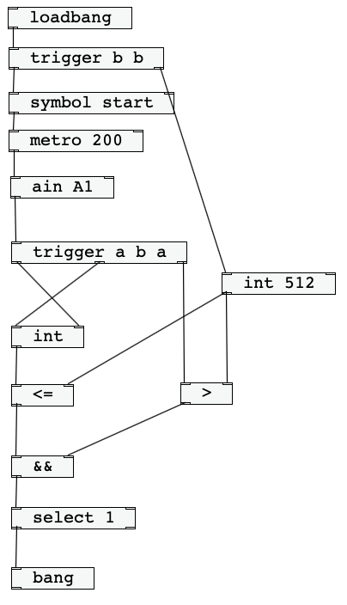
Triggering by the Input Value
Use the program on the left to detect when the analog input crossed the threshold value.
analog input
the threshold value
time
we want to detect these crossings

Slide 36
Triggering by the Input Value
First, the loadbang object send a bang message to the trigger object.
Then, the trigger object sends out a bang message from its right outlet first. This message is received by the int object.
Then, it sets the stored values of the ‘less-than-or-equal-to’ (<=) object and the ‘greater-than’ objects (>) object to 512. This is the thresholding value.

Slide 37
Triggering by the Input Value
Then, the bang message is received by the symbol object, resulting the analog input to be read every 200 msec.

Slide 38
Triggering by the Input Value
When the analog input value is received by the trigger object, first it sends out the input value as it is to the greater-than object.
It compares the input value to the stored value and output the result (1 or 0) to the logical-and (&&) object.
The logical-and (&&) object stores the input at its right inlet.

Slide 39
Triggering by the Input Value
Then, the trigger object send out a bang message from the second outlet (as the second argument is ‘b’, whatever it receives, it sends out a bang message from the second outlet).
When the int object received the bang message, it sends out the stored value (the default is zero, yet this int object normally holds the last input value).
Then, the output from the int object is compared with the threshold value at the <= object. The result (1/0) will be send to the && object.

Slide 40
Triggering by the Input Value
The && object will send out 1, if the both conditions are ‘1’ (true), and 0, if either of them is ‘0’ (false).
What does this mean?

Slide 41
Triggering by the Input Value
The && object will send out 1, if the both conditions are ‘1’ (true), and 0, if either of them is ‘0’ (false).
What does this mean?
When will the output be ‘1’?
the previous analog input is less than or equal to the threshold value.
The new analog input is greater than the threshold value.

Slide 42
Triggering by the Input Value
So we now can detect these crossings
analog input
the threshold value
time
we want to detect these crossings

Slide 43
Triggering by the Input Value
After checking the condition at the ‘&&’ object, the trigger object sends out the current analog input value to the ‘int’ object.
As the int value is received at the right inlet of the ‘int’ object, it just stores the input value.
This input value will be used as the previous analog input value when the next input value is output from the ain object.

Slide 44
Ardestan: Exercise 04
Now, modify the program to start blinking a LED (1 sec on/1 sec off), when the analog input value from the potentiometer go beyond 512.

Slide 45
Ardestan: Exercise 05
We may also want to detect when the input value goes from the above to the below a certain threshold?
Modify the program. This time start blinking a LED when the analog input value go below 512.
analog input
the threshold value
time
we want to detect these crossings

Slide 46
Subpatch
Subpatch
Writing the same code is not just tiring, it makes it harder to comprehend what the program does.
You can create your own Ardestan object by subpatching and reuse it.

Slide 47
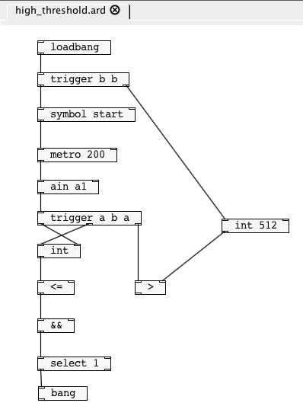
Subpatch
First, create a new file ‘high_threshold.ard’ and copy the program.
Make it sure that you saved it.

Slide 48
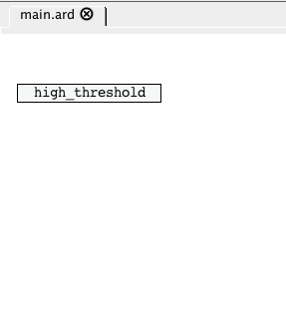
Subpatch
Then you can use the ‘high_threshold’ object in other program!
But there is no inlet/outlet in this object.

Slide 49
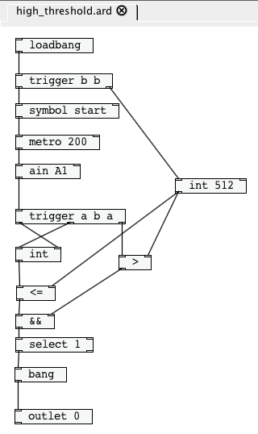
Subpatch
Create an outlet object.
The argument you give will be the outlet number where the output from this program is sent out to the parent program.
Make it sure you save it.

Slide 50
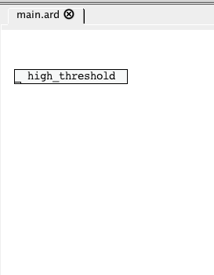
Subpatch
Now, the high_threshold object in the parent patch has one outlet (outlet #0)!

Slide 51
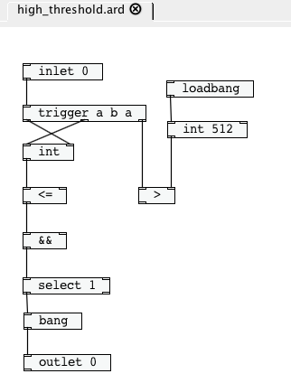
Subpatch
Now let’s create an inlet so that your subpatch can receive input.
Remove the part related to the analog input and instead receive it from the parent program.
Make it sure you save it

Slide 52
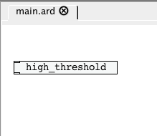
Subpatch
Now, the high_threshold object in the parent patch has one inlet (inlet #0)!
You can create up to 5 inlets and 8 outlets.
Just change the argument you give to the inlet and outlet objects to create more (for instance, ‘inlet 4’ creates 5 inlets (inlet #0-inlet #4)

Slide 53
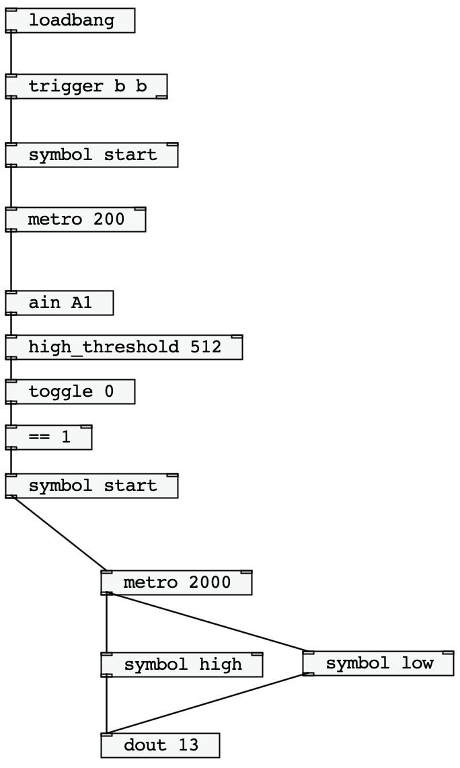
Subpatch
Now you can use the high_threshold object you created this way.

Slide 54
Subpatch
Now, we want to give this threshold value as an argument to the high_threshold object.

Slide 55
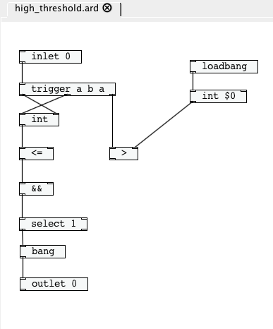
Subpatch
Now, we want to give this threshold value as an argument to the high_threshold object.
Use such value as $0, $1, $2, etc.

Slide 56
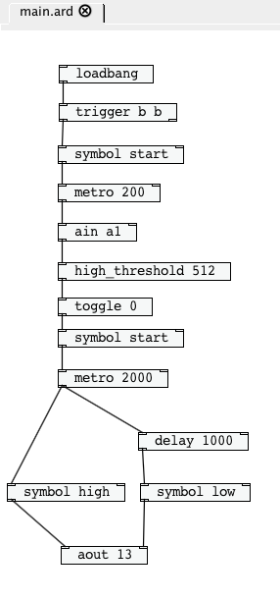
Subpatch
Then you can pass the values from your parent program as arguments to your object.
In the left program, you are giving 512. This will be used instead of $0 in the subpatch.

Slide 57
Subpatch
Now create a subpatch ‘low_threshold’ and use it in your program.

Slide 58
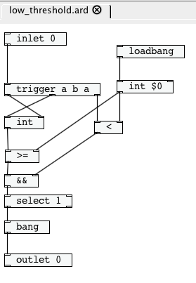
Triggering by the Input Value
Now create a subpatch ‘low_threshold’ and use it in your program.
Crossing the threshold from the above to the below means
The previous input value is greater than or equal to the threshold value
The new input value is less than the threshold value.
So we only change these two conditions.

Slide 59
Subpatch
One minor problem we want to fix is the initial previous value stored at the ‘int’ object.
Currently the program starts with the default value ’0’ for the int object.
Yet, this causes some problem as the real initial analog input is often not ‘0.’
How can we fix this problem?

Slide 60
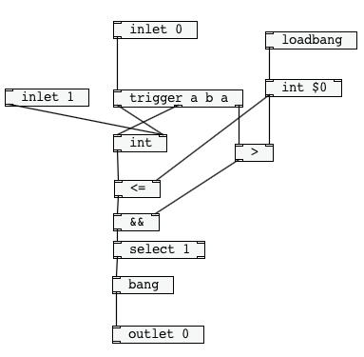
Subpatch
Let the int object receive the initial value from the parent program.

Slide 61
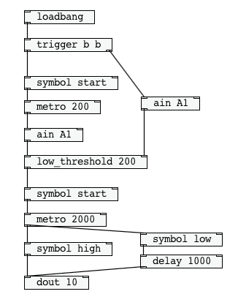
Subpatch
Let the int object receive the initial value from the parent program.
Using the trigger object, we can make it sure that the initial value is sent to the low_threshold object before the ‘metro’ starts.

Slide 62
Ardestan: Exercise 06
Write a program that uses the ‘low_threshold’ and ‘high_threshold’ subpatches.
When the analog input value crosses the high threshold (800) from the below to the above, turn on the LED.
Similarly when the analog input value crosses the low threshold (300) from the above to the below, turn off the LED.

Slide 63
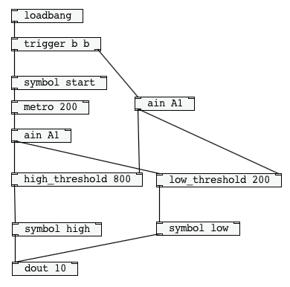
Ardestan: Exercise 06

Slide 64
More About Triggering by the Input Value
We still have some problems.
What happens when the analog input values fluctuate around the threshold…?
Too many events will be generated as the threshold value is crossed many times!
analog input
the threshold value
time
we want to detect these crossings

Slide 65
More About Triggering by the Input Value
Use two threshold values
When once the input value goes over the higher threshold, then until it goes below the lower threshold, it neglects any crossing over the higher threshold.
Similarly, once the input value goes below the lower threshold, it neglects any crossings over the lower threshold.
By this technique, it can avoid generating too many events even when the input value fluctuate around the threshold values.
This behavior significantly resembles the ‘McCulloch-Pitts neuron’ model in neural computing!
once it goes over the high threshold,
Other crossings at the high threshold will be neglected.
analog input
the threshold value (high)
the threshold value (low)
time
Once it crosses the low threshold, it can detect the crossing at the high threshold. Until it crosses the high threshold again, it neglects crossings at the low threshold.

Slide 66
More About Triggering by the Input Value
Implement this technique with the low_threshold object and high_threshold object.
Use two spigot objects and four int objects
analog input
the threshold value (high)
the threshold value (low)
time

Slide 67
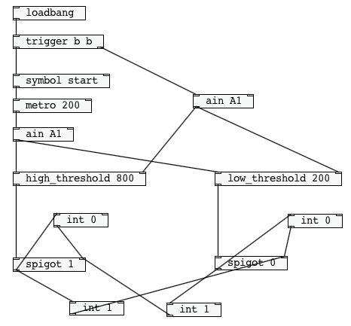
More About Triggering by the Input Value

Slide 68
More About Triggering by the Input Value
When the high-threshold crossing occurs, the spigot for the high-threshold object will receive a bang message.
bang
open
close

Slide 69
More About Triggering by the Input Value
As the spigot object is still open, first it lets a bang message go through.
bang
open
close

Slide 70
More About Triggering by the Input Value
The int ‘0’ closes the spigot for the high-threshold object.
So from now on, even if the high threshold is crossed, the ‘bang’ message output from the high_threshold object is blocked by the spigot object.
In other words, no high-threshold crossing event is invoked (=as the spigot block it).
0
close
close

Slide 71
More About Triggering by the Input Value
Similarly, the int ‘1’ opens the spigot for the low-threshold object.
So from now on, if the low threshold is crossed, the ‘bang’ message will be output from the low_threshold object and the spigot will pass through the bang message.
Now, the program only detects a low-threshold crossing and neglects a high-threshold crossing.
close
open
1
bang

Slide 72
More About Triggering by the Input Value
When the low-threshold crossing occurs, the spigot for the low-threshold object will receive a bang message.
bang
close
open

Slide 73
More About Triggering by the Input Value
The spigot object is open, so it passes through the bang message.
bang
close
open

Slide 74
More About Triggering by the Input Value
The int ‘0’ closes the spigot for the low-threshold object.
So from now on, even if the low threshold is crossed, the ‘bang’ message output from the low_threshold object is blocked by the spigot object.
close
close
0

Slide 75
More About Triggering by the Input Value
Similarly, the ‘int 1’ object receives a bang message and outputs ‘1’ to the spigot object.
Then the left spigot will be now open!
open
close
bang
1

Slide 76
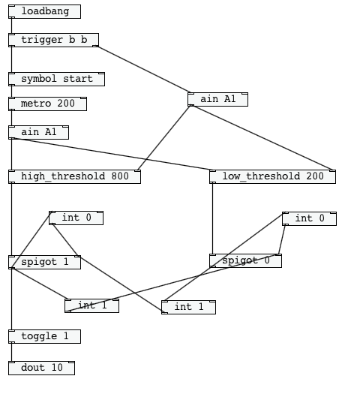
More About Triggering by the Input Value
Connect a LED to the digital out #10 and a potentiometer or other .
Test what happens.

Slide 77
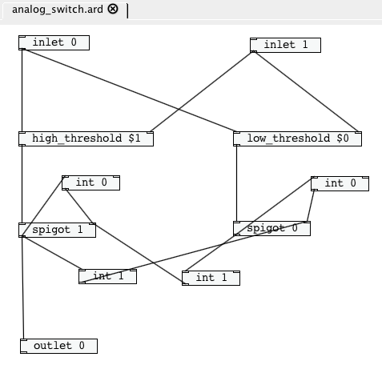
More About Subpatch
Create a new file ‘analog_switch.ard’ and use your high_threshold and low_threshold objects inside.

Slide 78
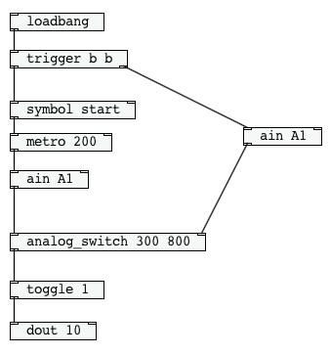
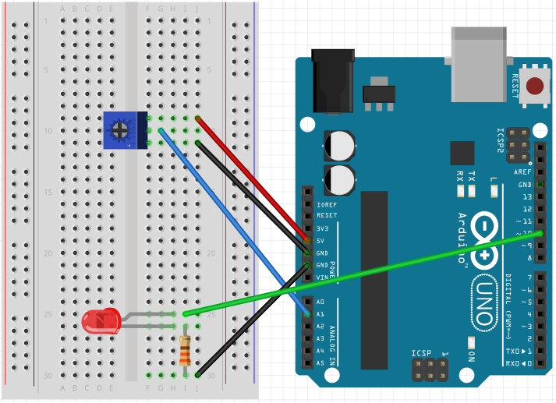
More About Subpatch
Modify the parent patch.
Test it with the Arduino.

Slide 79
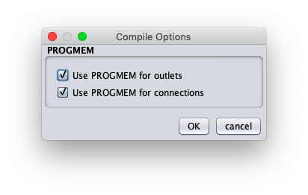
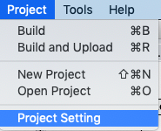
Memory Issues
As your program is getting larger, you might find that the Arduino UNO’s memory is not quite large for your Ardestan Program.
In this case, first try to change the project setting to use the PROGMEM area as below.

Slide 80
analog_switch object
We created our own analog switch object as a subpatch. However, it can consume some memory.
The Arduino Uno doesn’t have much memory and your program may not work if your program is too large for the Arduino Uno.
The analog_switch object is provided as an external object. Use it instead of your subpatch as possible.
Be sure not to create your own ‘analog_switch” object when you use this external object; if the subpatch has the same name as an external object, there can be a conflict that results in a bug.
See the help file t see how the analog_switch object is used.

Slide 81
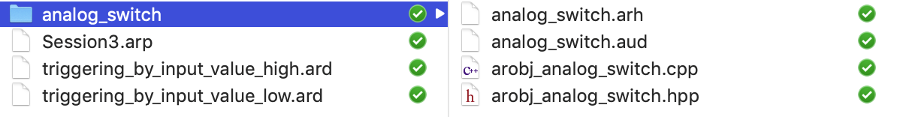
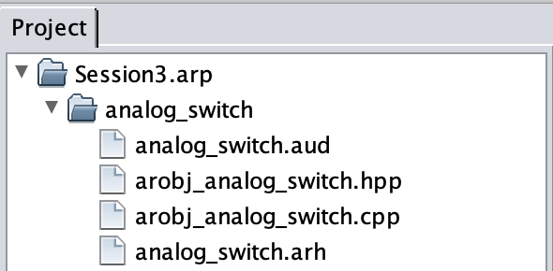
analog_switch object
To use the analog_switch object, first download the file: analog_switch.zip and unzip. Move the folder analog_switch to your project directory. Then, it will show up on the project explorer window.

Slide 82
What We Learned So Far
Analog Input and Output
PWM output
aout object
ain object
map object
voltage divider
Using an Analog Sensor as a switch
thresholding
triggering
Subpatch
Servomotor
Stepper Motor
Capacitive Sensing
Conductive Materials

Slide 83
Session 2.3: Servomotor and Stepper Motor

Slide 84
Servomotor
A servomotor is a rotary actuator or linear actuator that allows for precise control of angular or linear position, velocity and acceleration [1].
You can use a servomotor for many purposes.
For instance, you can control an arm of your robot.
http://www.princeton.edu/~mae412/TEXT/NTRAK2002/292-302.pdf
Image: https://c1.staticflickr.com/4/3091/2569961787_e7743762b3_b.jpg(CC BY-SA 2.0)

Slide 85
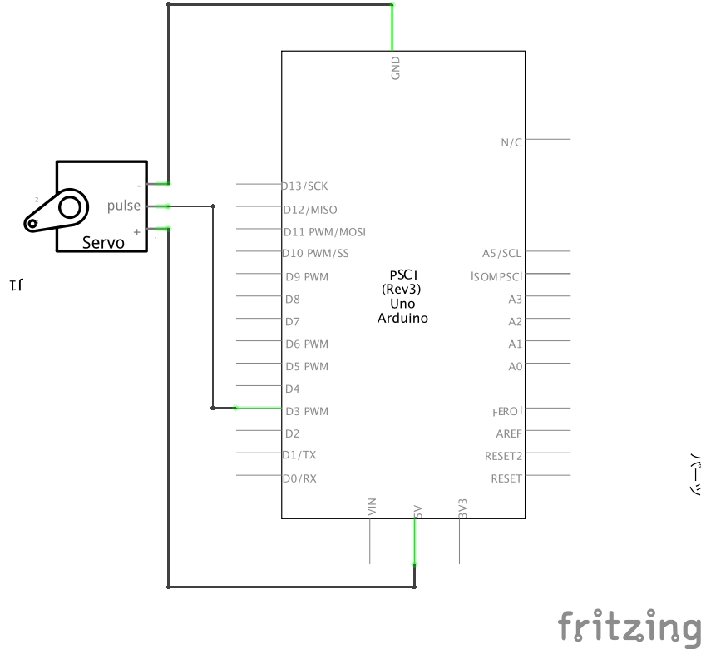
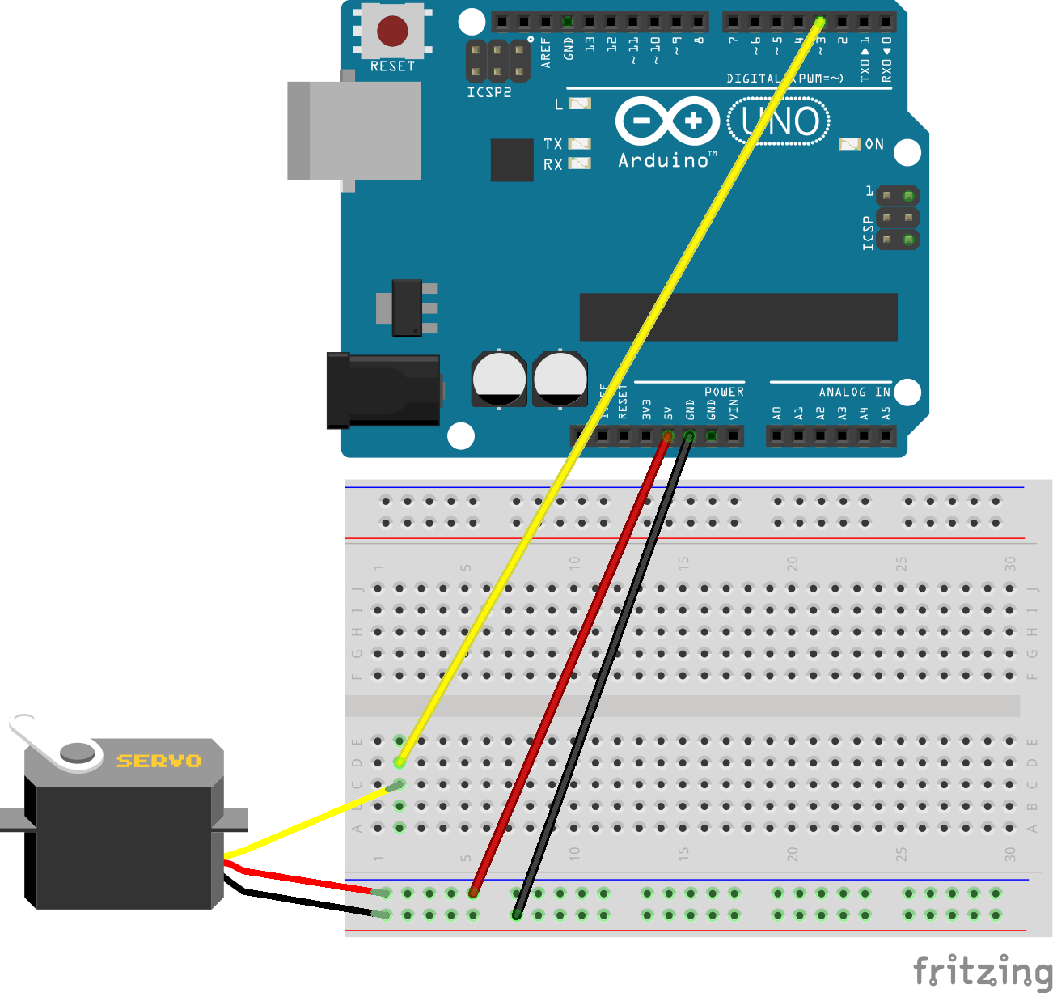
Servomotor

Slide 86
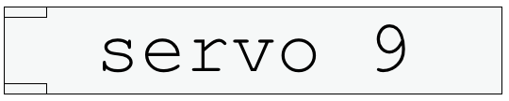
Servo Object
The servo object controls a servomotor.
The first argument is the pin number where the servomotor’s signal pin is connected.
As a servomotor is controlled by the PWM output, you must use the PWM output pin.
When an integer value (between 0 – 180) is received at the left inlet, the servo object rotates the servo motor.

Slide 87
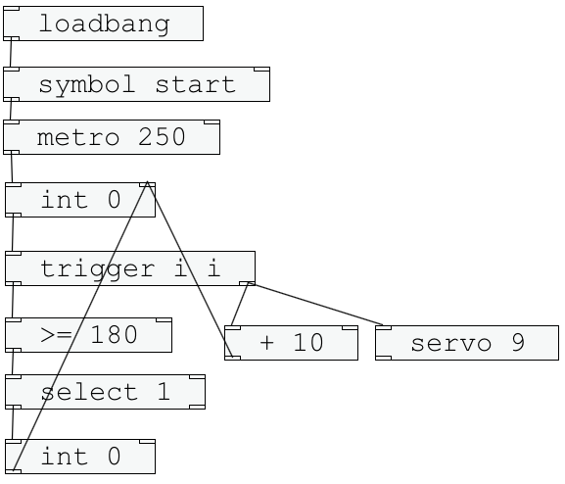
Ardestan: Example 03

Slide 88
Ardestan: Exercise 07
Write a program and design a circuit to control the angle of a servomotor by a potentiometer.

Slide 89
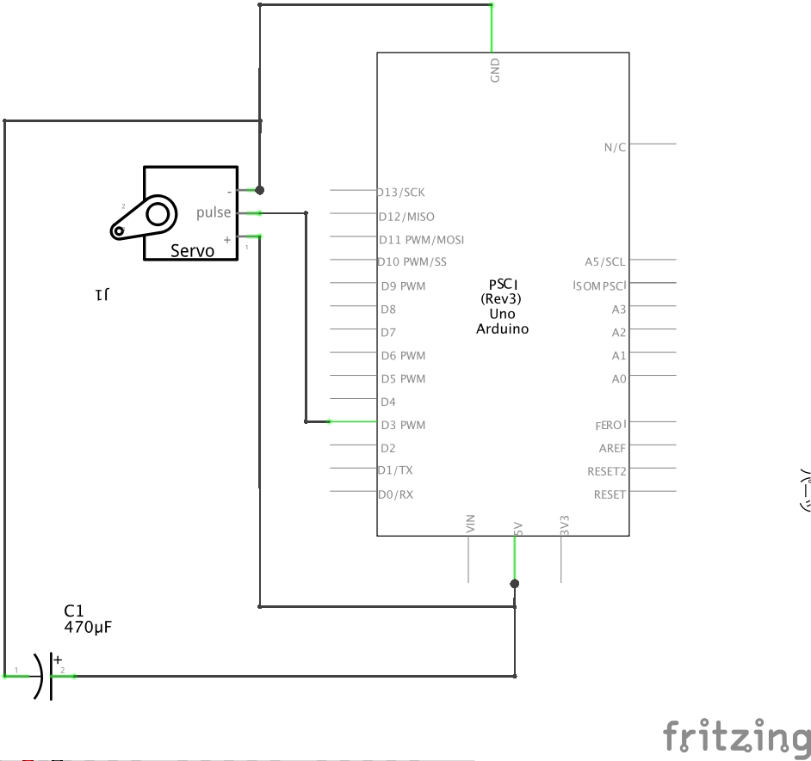

Servomotor
If your servo misbehaves, put a capacitor (470uF or greater) in your circuit.

Slide 90
Servomotor
Why?
“A capacitor is a passive two-terminal electrical component that stores electrical energy in an electric field” [1].
“The servo draws quite a lot of power, especially as the motor is starting up” and “this sudden high demand can be enough to drop the voltage on the Arduino board, so that it resets itself” [2].
“The capacitor acts as a reservoir of electricity for the motor to use, so that when it starts, it takes charge from the capacitor as well as the Arduino supply” [2]
[1] Alexander, Charles; Sadiku, Matthew. Fundamentals of Electric Circuits (3 ed.). McGraw-Hill. p. 206.
[2] https://learn.adafruit.com/adafruit-arduino-lesson-14-servo-motors/if-the-servo-misbehaves, accessed on Nov-23-2017

Slide 91
Stepper Motor
A Stepper motor is a kind of a motor that you can control its rotation step—by-step.
Image: https://www.sparkfun.com/products/10551 (CC BY 2.0)

Slide 92
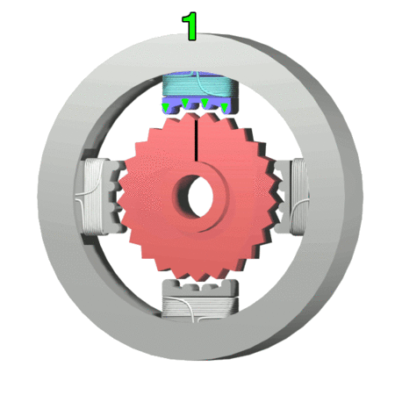
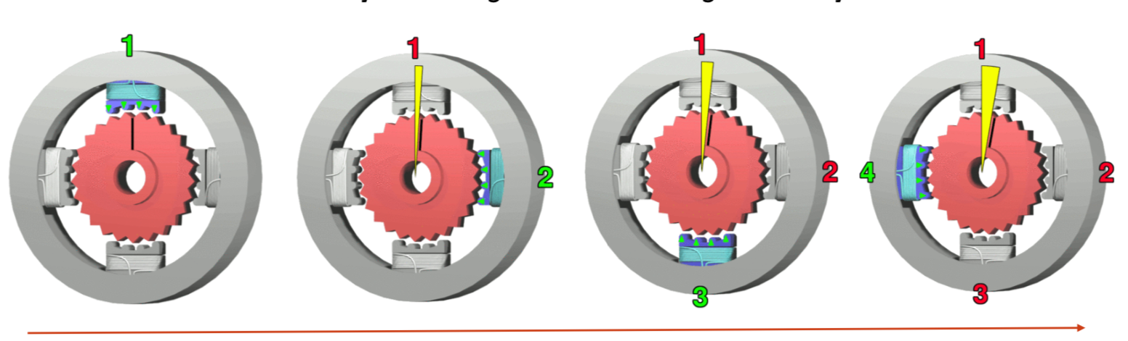
Stepper Motor
The rotation is controlled by activating each electromagnet one by one.

Slide 93
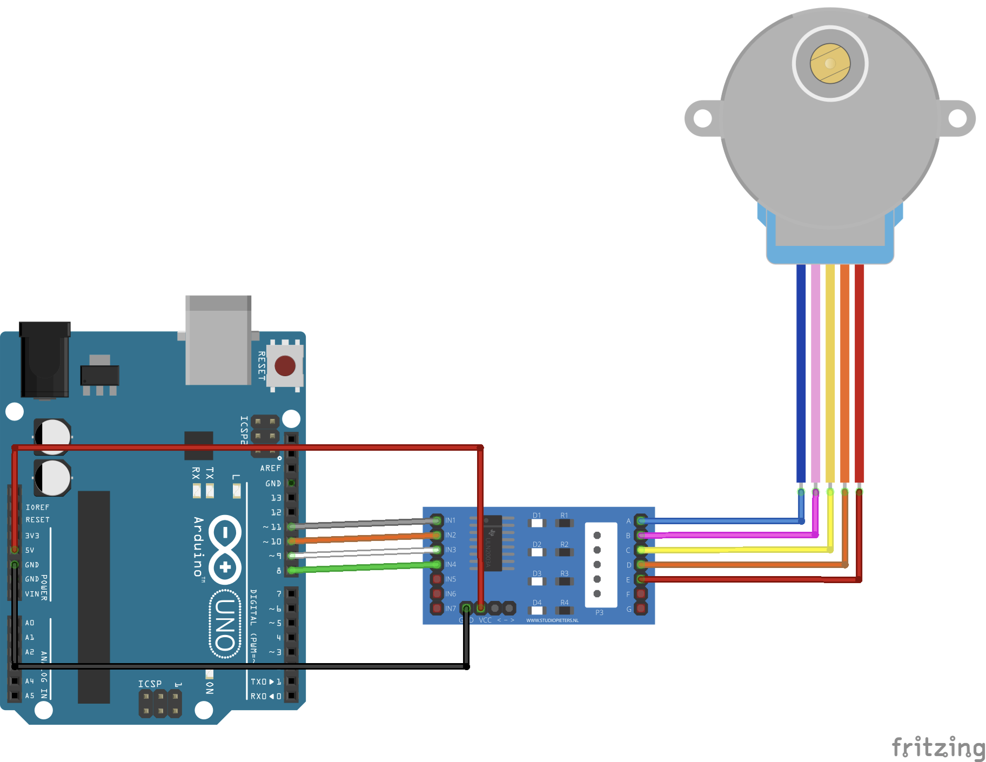
ULN2003
To control a stepper motor with the Arduino, we use the ULN2003 motor driver in this class.

Slide 94
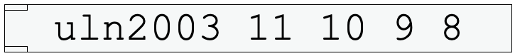
uln2003 object
The uln2003 object can control a stepper motor via the uln2003 driver.
The arguments are pin numbers that are connected to the uln2003 driver.
When it receives a symbol:left or right, it rotates the stepper motor one step to the left or the right accordingly.

Slide 95
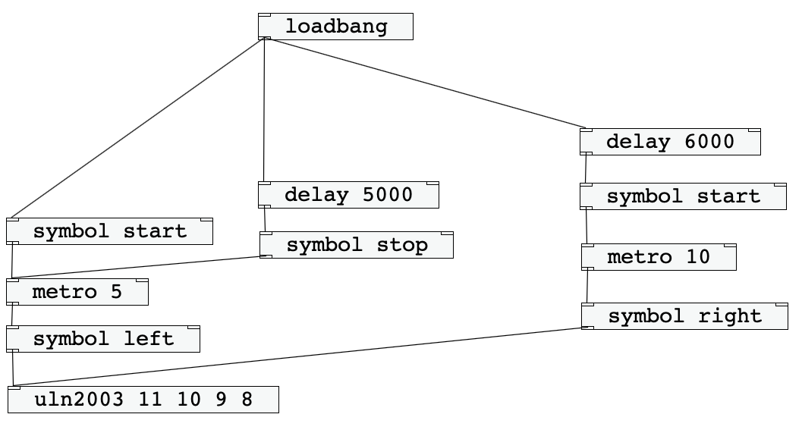
Ardestan: Example 04

Slide 96
Ardestan: Exercise 08
Create a circuit with two buttons and one stepper motor.
Write a program to control the rotation of the stepper motor.
While the left button is pressed, rotate the stepper motor to the left.
While the right button is pressed, rotate the stepper motor to the right.

Slide 97
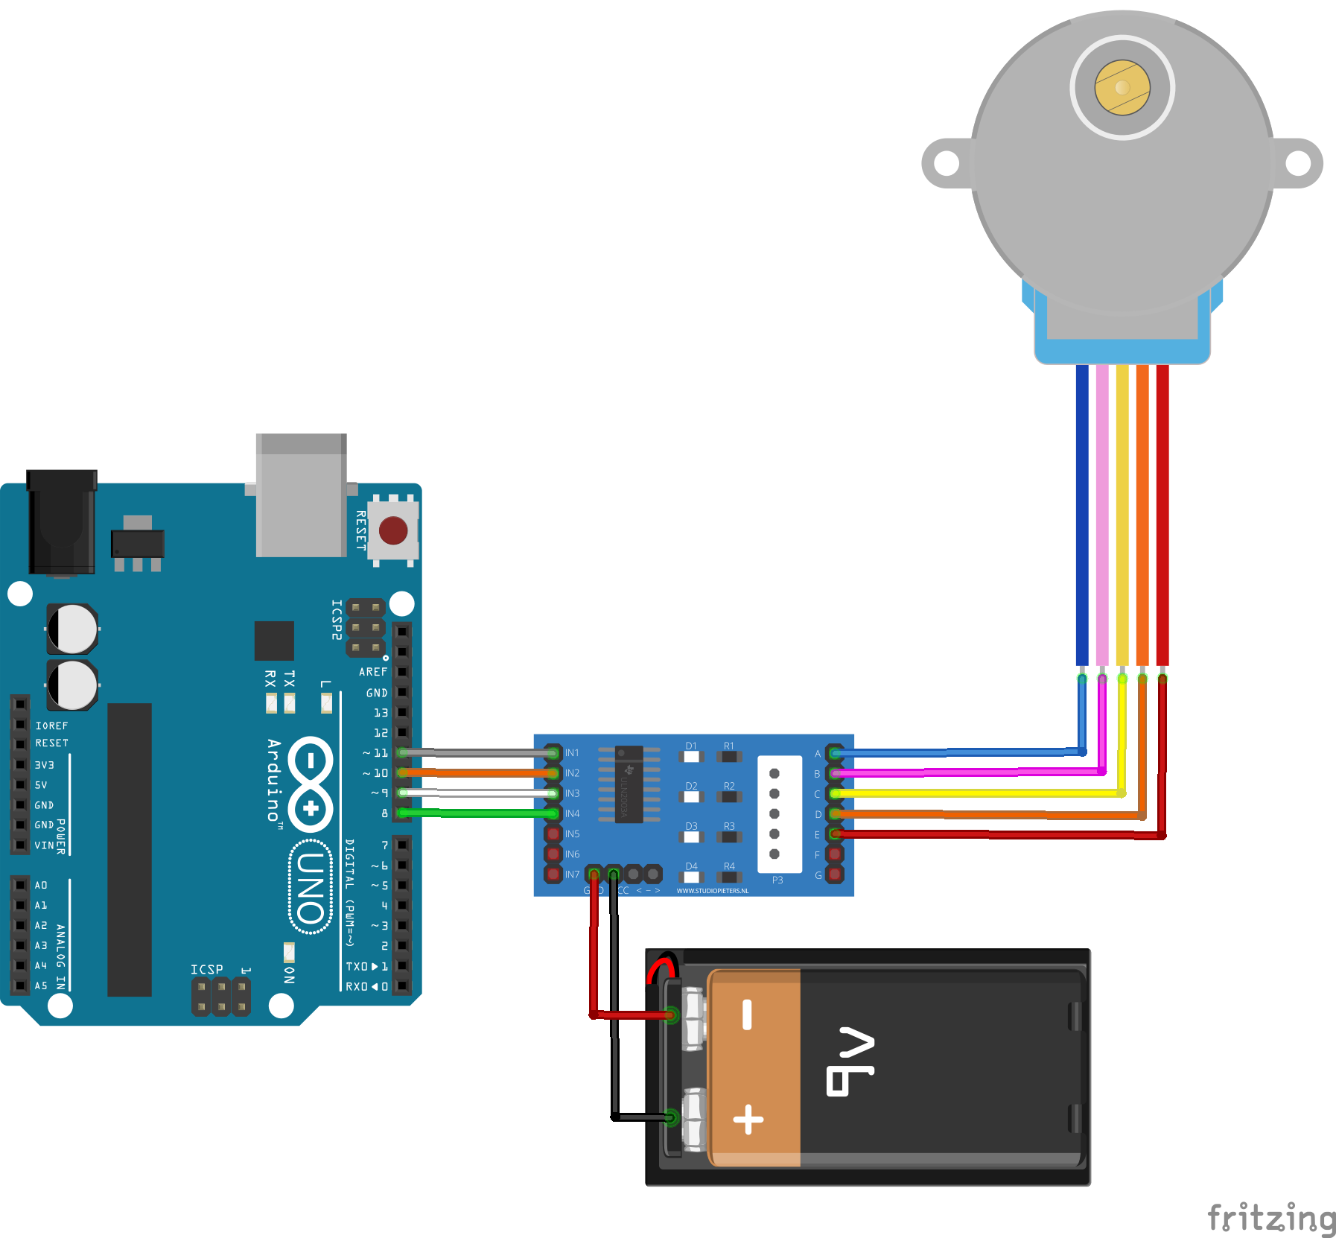
uln2003
If the Arduino’s digital output doesn’t supply enough electric current or voltage for your stepper motor, connect an external power source.

Slide 98
What We Learn Today
Analog Input and Output
PWM output
aout object
ain object
map object
voltage divider
Using an Analog Sensor as a switch
thresholding
triggering
Subpatch
Servomotor
Stepper Motor
Capacitive Sensing
Conductive Materials

Slide 99
Session 2.4: Capacitive Sensing and Conductive Materials

Slide 100
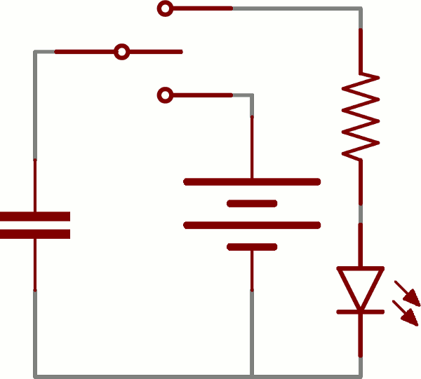
Capacitor
Capacitor is composed of two conductive surfaces with one non-conductive layer in between. One surface is connected to the positive pole and the other is connected to the GND.
Capacitors can charge electrical potential energy and release it.
Image (left) : https://publicdomainvectors.org/en/free-clipart/Parallel-plate-capacitor-vector-drawing/26061.html (public domain)
Image (middle): https://commons.wikimedia.org/wiki/File:Electronic-Component-Elec-Capacitors.jpg (public domain)
Image (right) : https://learn.sparkfun.com/tutorials/capacitors/capacitor-theory (CC BY-SA 4.0)

Slide 101

Capacitive Sensing
send pin
receive pin
Anything capacitive can be used as a sensor.
A conductive surface will work as a capacitor, if any other conductive surface comes closer to the surface.
If we send a pulse to a capacitor, it can charge the capacitor. Then, the energy is released quickly but with some delay caused by the capacitor (note that we’re sending a pulse; we quickly turn off the electric current).
By measuring the delay, we can sense proximity/touch.
R
foil

Slide 102
Coke Piano and Launchpad made with Arduino
video: https://www.youtube.com/watch?v=Ttm62RBdOuo&t=7s

Slide 103

Awake – An Interactive Painting by Sofia Arnov
Awake – An Interactive Painting by Sofia Arnov: https://vimeo.com/180955071 CC BY-NC-ND 3.0

Slide 104
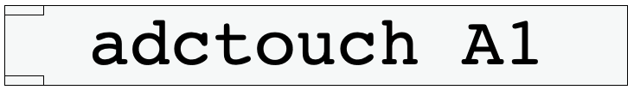
adctouch object
analog pin
The adctouch object can perform capacitive sensing just with one pin.
When it receives a ‘bang’ at the left outlet, it reads the current value obtained by capacitive sensing and output an integer value from its outlet.
foil

Slide 105


adctouch object
To utilize the adctouch object, first install the ADCTouch library (Menu: Tools->Library Manager).

Slide 106

adctouch object
Then, download the file: adctouch.zip from the course website, and unzip it.
Move the directory: adctouch to your project directory. The adctouch object should appear in the project explorer.

Slide 107

Ardestan: Example 05
Test this example with conductive ink

Slide 108
analog_switch2 object
Use analog_switch2 to facilitate the utilization of capacitive sensing as a trigger (the zip file is uploaded to the course website).
Similarly as the analog_switch object, it can utilize the sensor as an event trigger with two threshold values.
The difference is that this object received an integer input, instead of reading the actual analog input value.

Slide 109

analog_switch2 object

Slide 110
Conductive Materials
There are various conductive materials.
Conductive thread and fabric can be used for capacitive sensing.
Image left : https://www.sparkfun.com/products/retired/10055 (CC BY 2.0)
Image right: https://www.sparkfun.com/products/10867 (CC BY 2.0)

Slide 111
Conductive Materials
There are various conductive materials.
Conductive rubber and soft potentiometer can be used in a voltage divider circuit (with the analog input).
Images from: https://www.adafruit.com

Slide 112
What We Learned Today
Analog Input and Output
PWM output
aout object
ain object
map object
voltage divider
Using an Analog Sensor as a switch
thresholding
triggering
Subpatch
Servomotor
Stepper Motor
Capacitive Sensing
Conductive Materials

